Slide 1


Course No: CSE 2188 Course Title: Software Engineering Sessional
“Heaven’s light is our guide”
RAJSHAHI UNIVERSITY OF ENGINEERING & TECHNOLOGY
DEPARTMENT OF MECHATRONICS ENGNEERING

Slide 2

Team Members:
NAME ROLL NO
Azim Miah 1808028
Bishowjit Paul 1808029
A. K. M. Mohibur Rahman 1808030
Abu Bakar Siddik 1808031
Enamul Hasan 1808032

Slide 3
Software Project PATHFINDING VISUALIZER

Slide 4
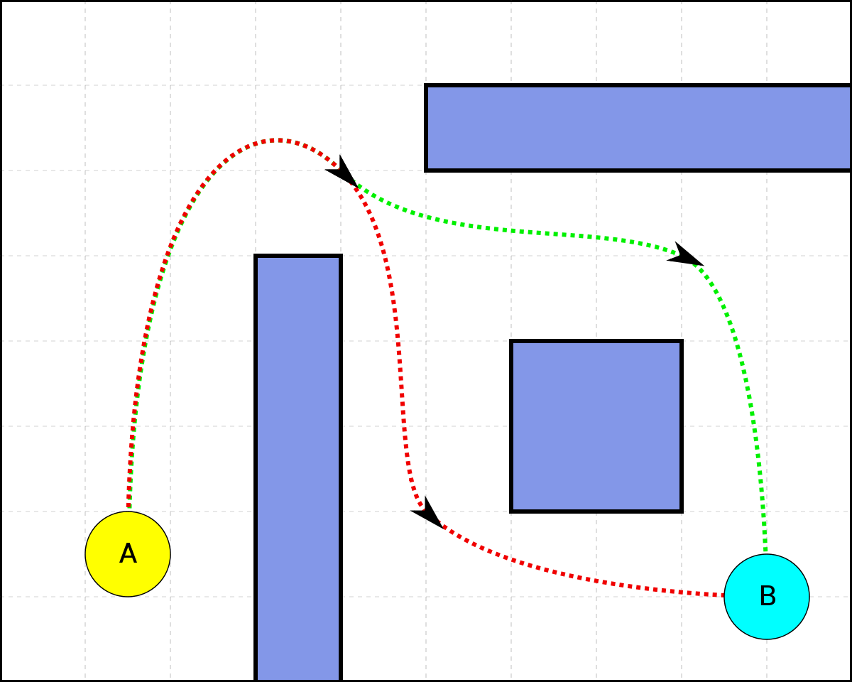
WHAT IS PATHFINDING VISUALIZER?
Process of discovering shortest path through obstacles between two points.

Slide 5
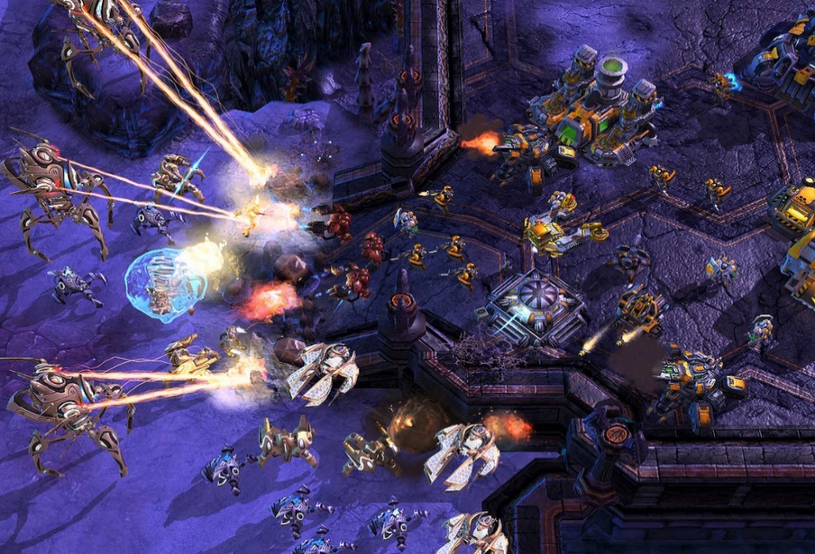
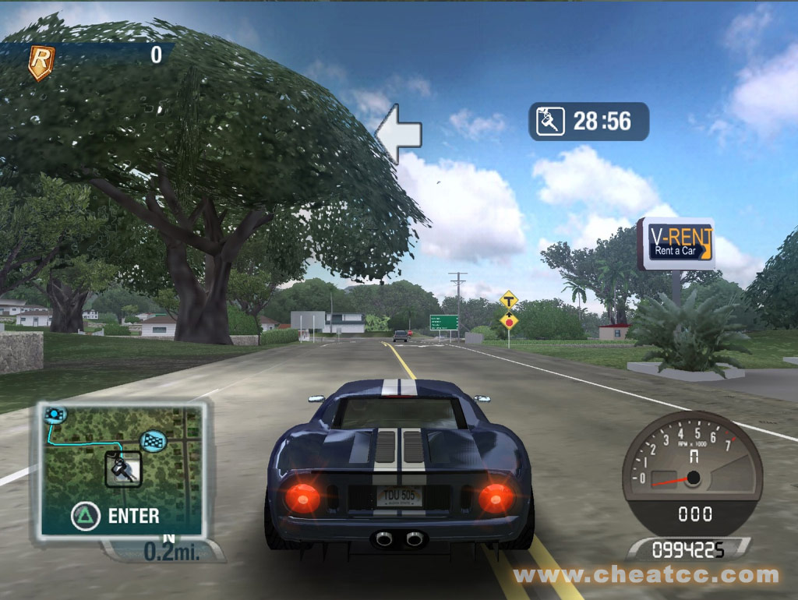

PATHFINDING IN GAMES

Slide 6
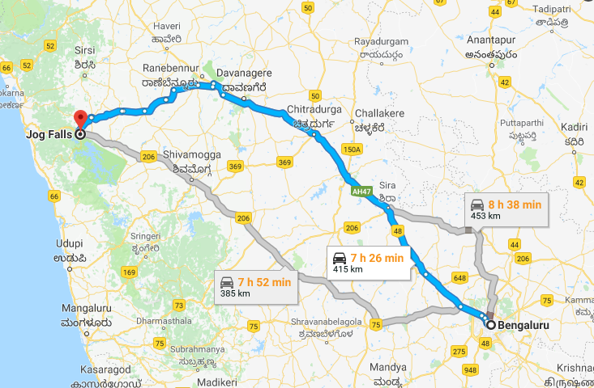
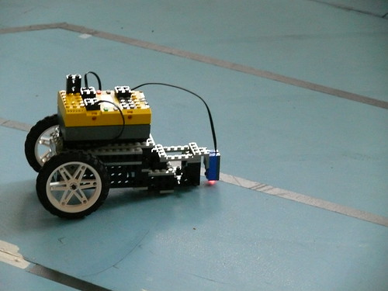
JUST FOR GAMES? No! Pathfinding is important for building complex HTML5 apps
Fastest Route
Pathfinding Robot

Slide 7
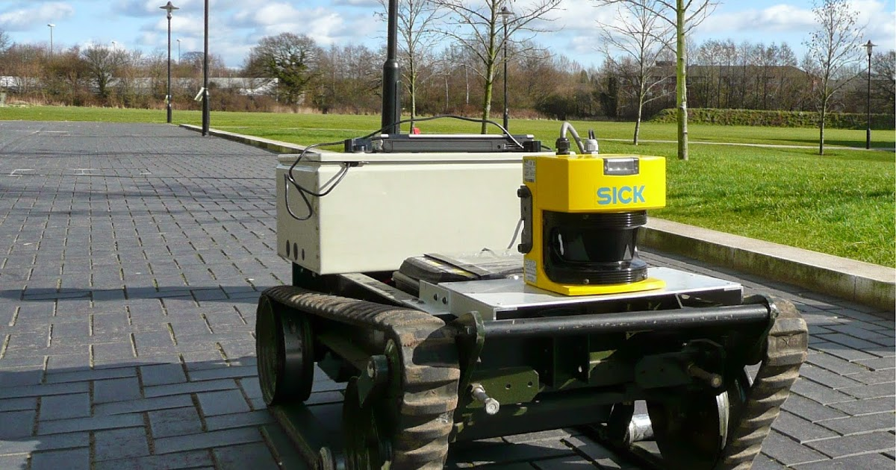

Robotics Engineering
Acquire Resources

Slide 8
PATHFINDING ALGORITHMS:
A*
IDA*
BREADTH-FIRST-SEARCH
DEPTH-FIRST-SEARCH
BEST-FIRST-SEARCH
DIJKSTRA
JUMP POINT SEARCH
ORTHOGONAL JUMP POINT SEARCH
TRACE

Slide 9
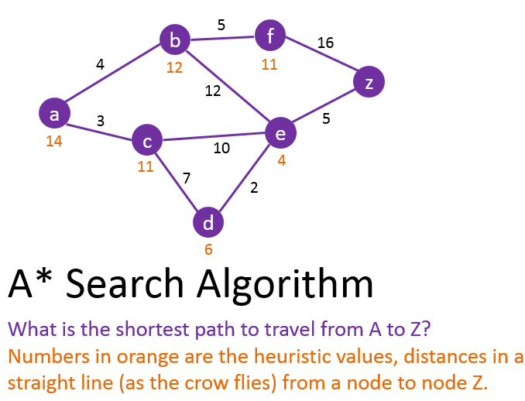
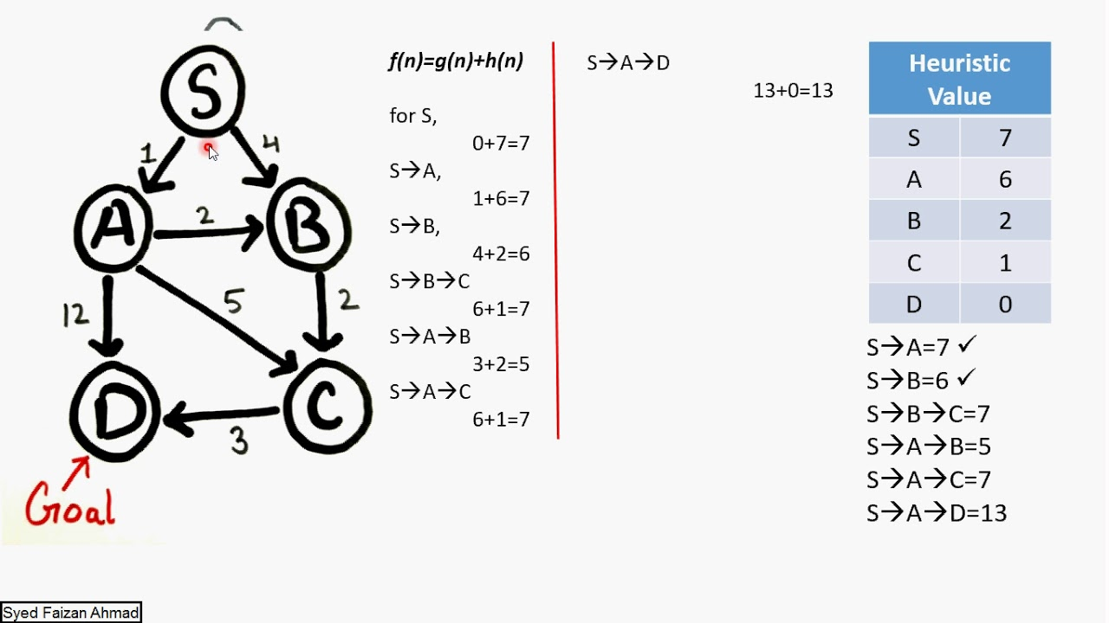
A* Algorithm Explanation with examples:

Slide 10

Programming Languages we have chosen to develop this software:

Slide 11

PLATFORM: 1.QT CREATOR 2.KINTER

Slide 12
THANK YOU

